Slide 10
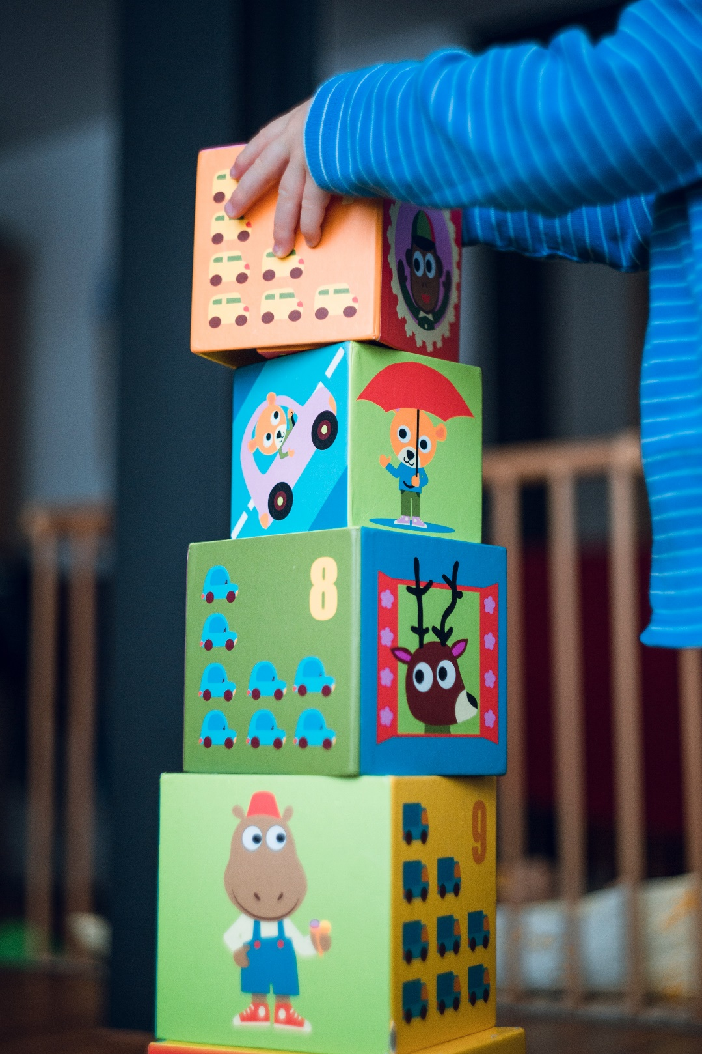
PRAYGROUND
IF YOU HAVE KIDDOS ALONG TODAY WE UNDERSTAND THEY WANT TO BE BUSY…AND MIGHT MAKE A BIT OF NOISE!
ACTIVITY TABLES AND TOYS CAN BE FOUND AT THE BACK OF THE CHURCH.

Slide 11
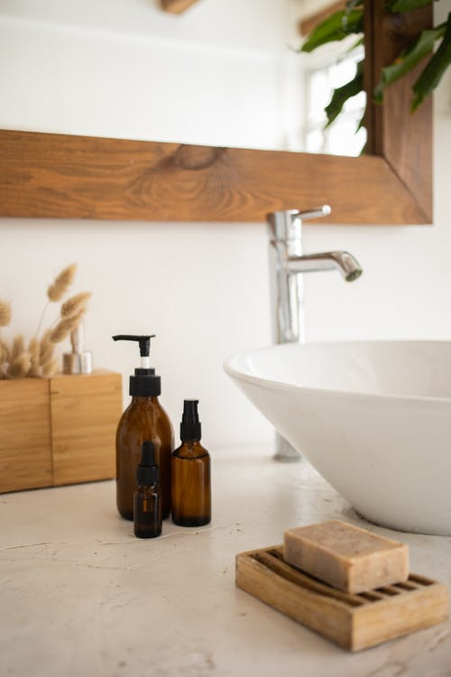
VISITING TODAY?
WASHROOMS CAN BE FOUND JUST OUT OUR SIDE DOOR AS WELL AS DOWNSTAIRS.

Slide 12
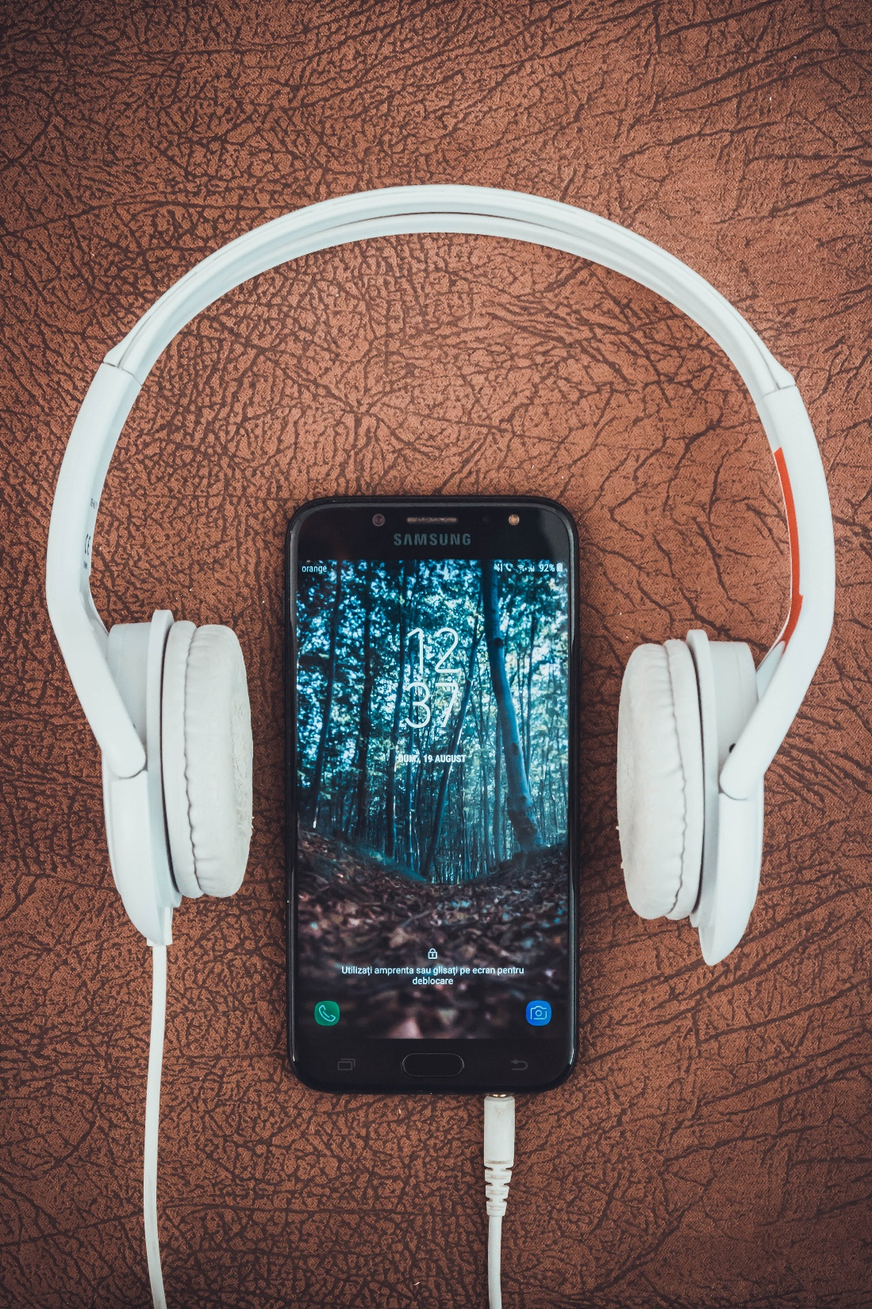
TUNING IN!
Headphones are available at the back if you’d like to “tune in” to hear the service more clearly!

Slide 13
PLEASE JOIN US FOR COFFEE & FELLOWSHIP AFTER THE SERVICE! THE HALL IS STRAIGHT OUT OUR SIDE DOOR
IF YOU ARE INTERESTED IN HELPING OUT PLEASE SIGN-UP ON THE SHEET IN THE HALL

Slide 14
DID YOU KNOW? WE HAVE A LIBRARY!
BOTH CHILDREN AND ADULT BOOKS ARE AVAILABLE TO SIGN-OUT IN THE PARLOUR

Slide 15
WHAT’S NEW?
SIGN UP TO OUR EMAIL LIST TO RECEIVE IMPORTANT NEWSLETTERS AND OTHER HELPFUL INFORMATION!
CONTACT THE OFFICE TO SIGN UP
office@lacombeunitedchurch.ca
403-782-3148

Slide 16
ORDER OF SERVICE:
IF YOU ARE JOINING US IN PERSON TODAY, THE ORDER OF SERVICE CAN BE FOUND ON THE PEDESTAL OUTSIDE OUR MAIN ENTRANCE AND ON THE DOOR OF OUR SIDE ENTRANCE
TO FOLLOW ALONG ONLINE PLEASE GO TO OUR WEBPAGE AT:
https://www.lacombeunitedchurch.ca/bulletin/

Slide 17
ANNOUNCEMENTS:
DO YOU HAVE SOMETHING YOU’D LIKE ADVERTISED ON OUR POWERPOINT?
PLEASE SUBMIT YOUR REQUEST TO THE OFFICE:
OFFICE@LACOMBEUNITEDCHURCH.CA

